Slide 1
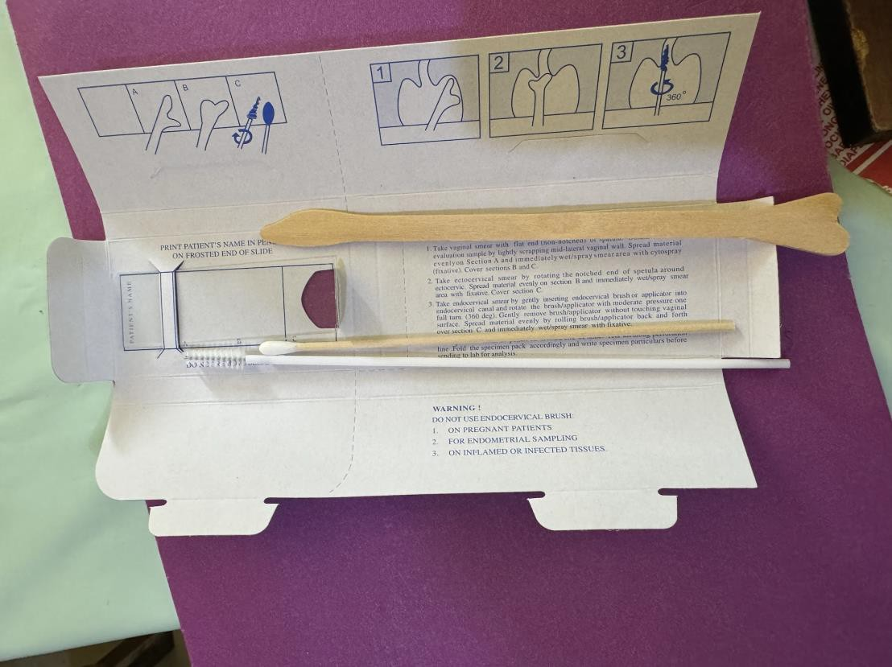
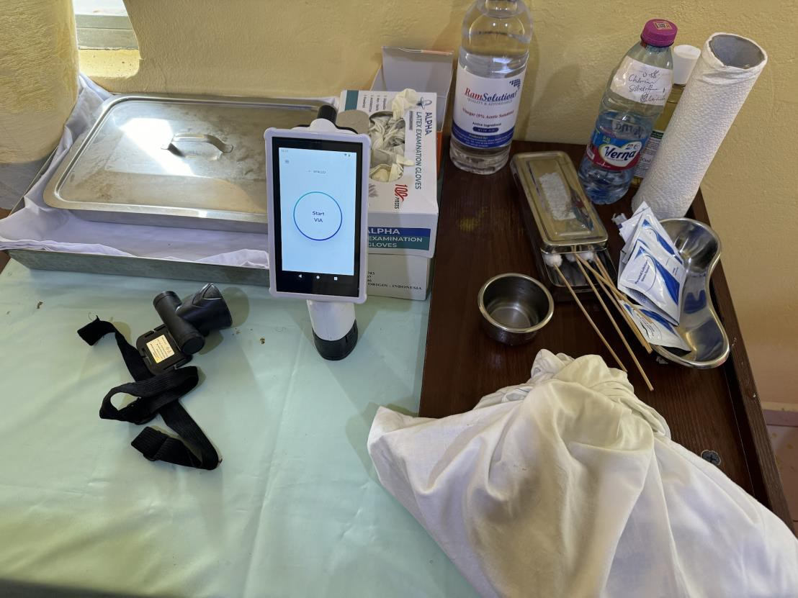
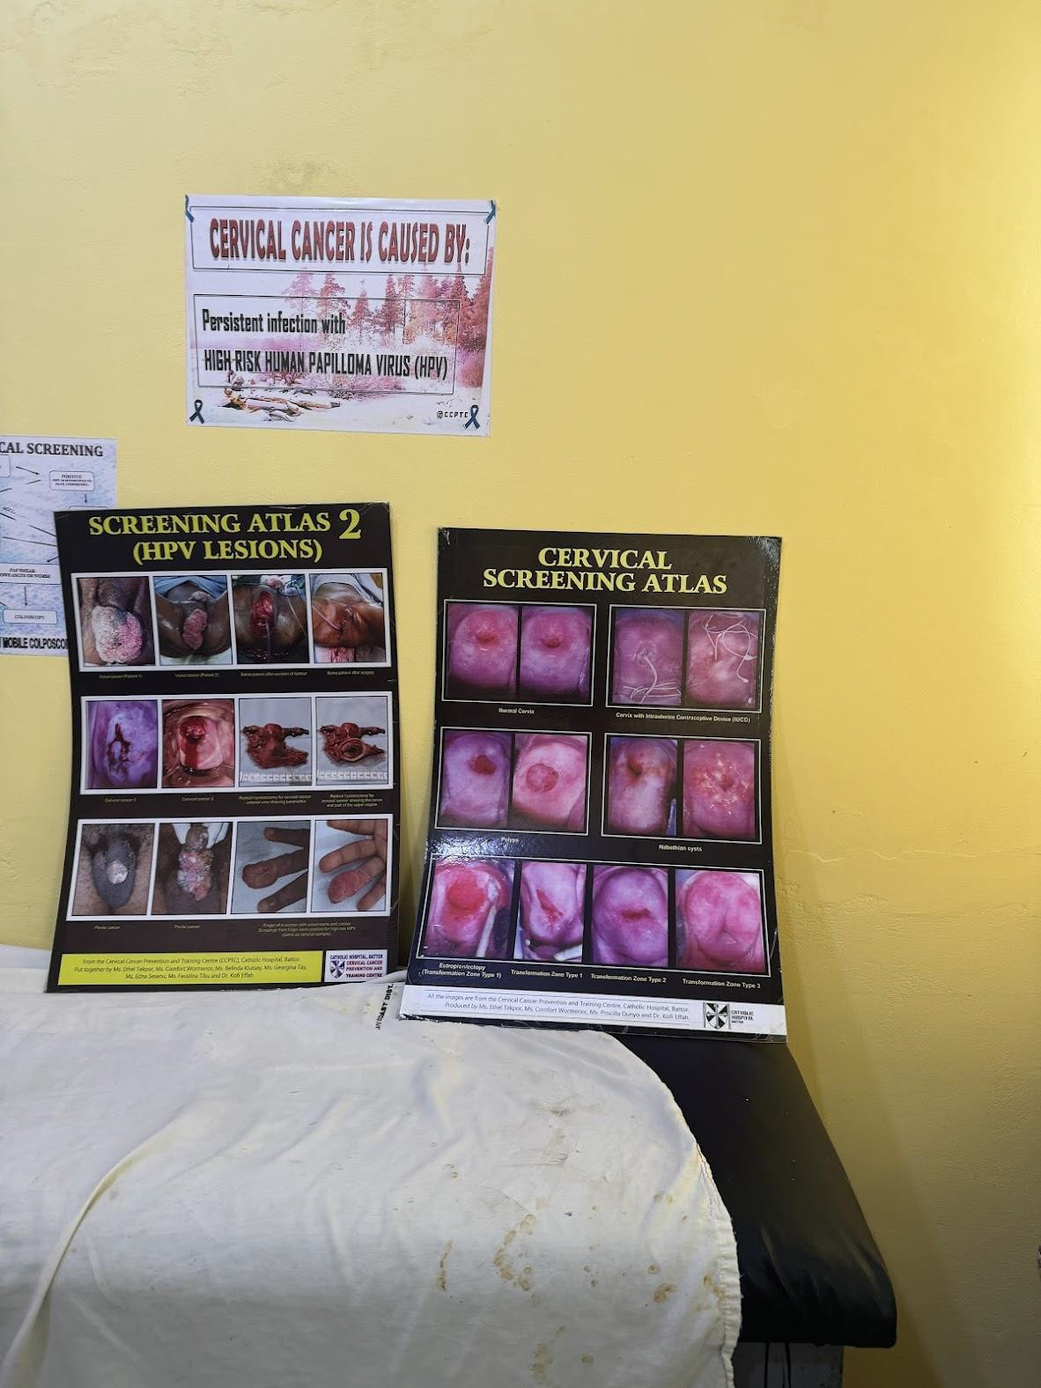
Addressing Cervical Cancer Disparities through Community Outreach & Collaborative Training in Cape Coast, Ghana
V. Mehta,¹; J. Hollingsworth¹, J. Aikins¹, C. Ayers¹
¹Department of OB/GYN. Robert Wood Johnson Medical School, Piscataway, NJ 08854 2. Division of Gynecologic Oncology, Department of OBGYN,
Goal: To increase cervical cancer screening and education through a global lens by facilitating comprehensive workshops and emphasizing collaborative training
2-day screening session goals:
Collaborate with community health works
Educate on cervical cancer
Screen 20 women, including healthcare workers and patients
Offer clinical breast
examinations
Pap collection kit
Mobile colposcope
20 patients screened via direct colposcopic visualization and pap smear
6 patients (30%) had suspicious
colposcopic findings and were referred for further screening
Significance
Cervical cancer is the 2nd most frequent cancer among women in Ghana
Approximately 2.7% of Ghanian women obtain regular cervical cancer screening
Cervical cancer incidence in Ghana is approximately 30.7 per 100,000 women vs.
6.6 per 100,000 in developed countries
Medical personnel at Cape Coast Metro Hospital were unaware of the screening capabilities of their own institution
Screening costs: 150 Cedis (USD $9.33)
Conclusion/Implications
Addressing cervical cancer screening disparities in Ghana requires a multifaceted approach that prioritizes community engagement and the empowerment of healthcare workers
Assess gaps/barriers
Needs • Formulate goal/vision
assessments
Goal
Collaborate with community to spread the word
Education
Collaborate Advocate Outreach
Acknowledgements
International Healthcare Volunteers (IHCV)
Cape Coast Metropolitan Hospital
94%
Cervical cancer- related deaths occurred in LMIC
80%
Patients in LMIC present to hospital after onset of symptoms
Protocol development
Implementation
Implement strategy
Evaluate strategy outcomes
Identify further gaps
Assess outcome
References
International Agency for Research on Cancer. (2002). Globocan.
Retrieved October 3, 2007, from http://www-dep.iarc.fr/
Abotchie, P. N., & Shokar, N. K. (2009). Cervical cancer screening
among college students in Ghana: Knowledge and health
beliefs. International Journal of Gynecological Cancer, 19(3), 412
416. https://doi.org/10.1111/IGC.0b013e3181a1d6de
University of Zimbabwe/JHPIEGO Cervical Cancer Project. (1999). Visual inspection with acetic acid for cervical cancer screening: Test qualities in a primary care setting. The Lancet, 353(9156), 869-873.
2.7%
Ghanian women obtain regular screening

